Slide 1
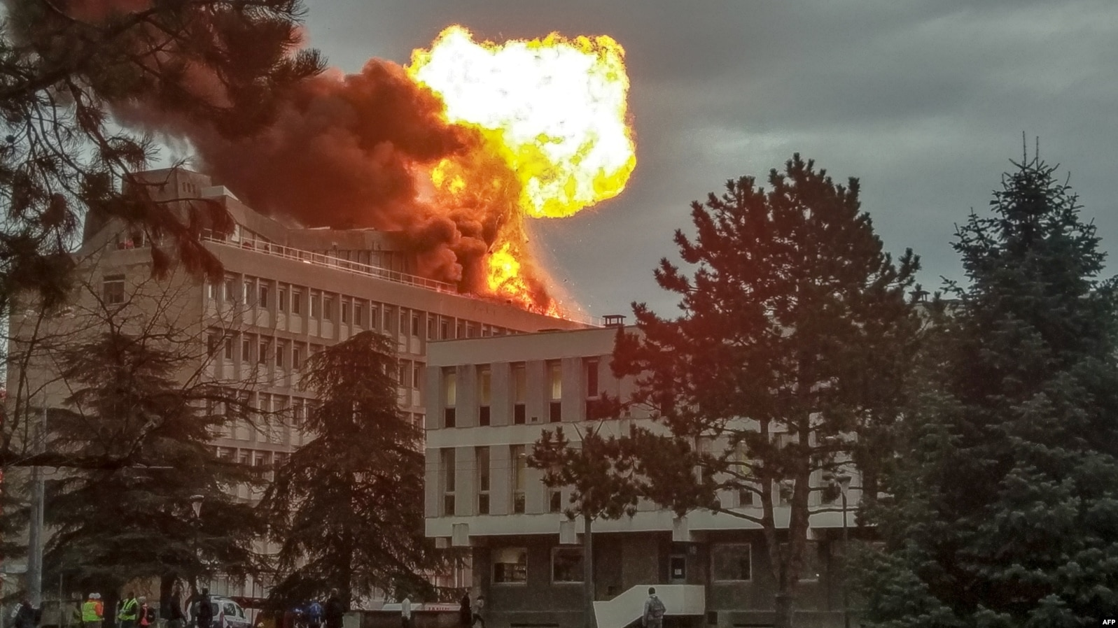
Fire Detection and Evacuation System for Campuses
Work of
Giorgos Xagorarakis
Natalia Rouska
Sotiris Sveronis
https://www.voanews.com/a/strong-explosion-fire-hits-french-university-building/4747134.html

Slide 2






Problem statement
Three fires occurred in August 2025 at the University Campus of Patras.
Existing fire detection systems and evacuation plans are restricted to indoor areas.
A lack of real-time fire detection, monitoring, and forecasting of potential spread.
Absence of real-time evacuation guidance for pedestrians and vehicles.
Temperature, smoke, humidity sensors are expensive and unreliable for detection
Notes:
ναταλια

Slide 3


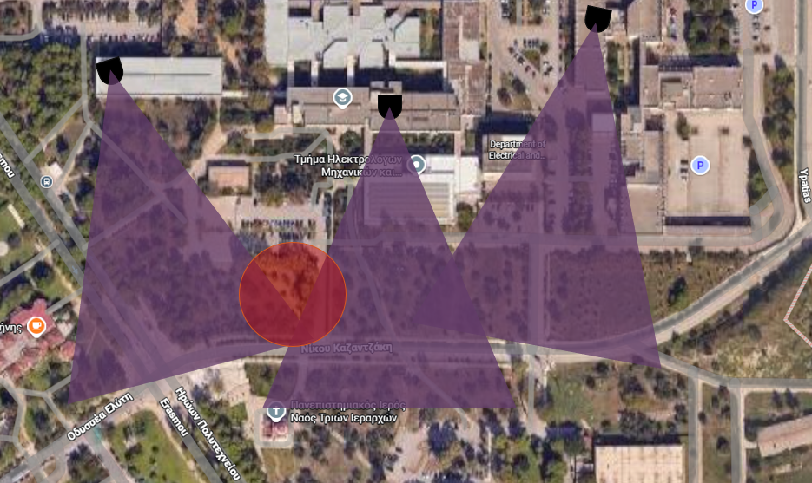

Solution: IoT Smart System Part 1
Forecasting the fire spread direction combined with weather API information
CCTV based system using AI model for fire detection and geopositioning in the outdoor areas of campus
Utilize the existing CCTV infrastructure, supplemented by additional cameras where necessary, to eliminate blind spots and minimize overall costs.
Notes:
ναταλια

Slide 4




Solution: IoT Smart System Part 2
Monitoring vehicles in parking lots with parking sensors
Simulation of the optimal evacuation flow distribution for vehicles and pedestrians in live map with existing solver
Monitoring crowds in buildings using access-point wireless traffic analysis and radar people counter
Public website application with admin and user interface for real-time monitoring and guidance
Notes:
ναταλια

Slide 5
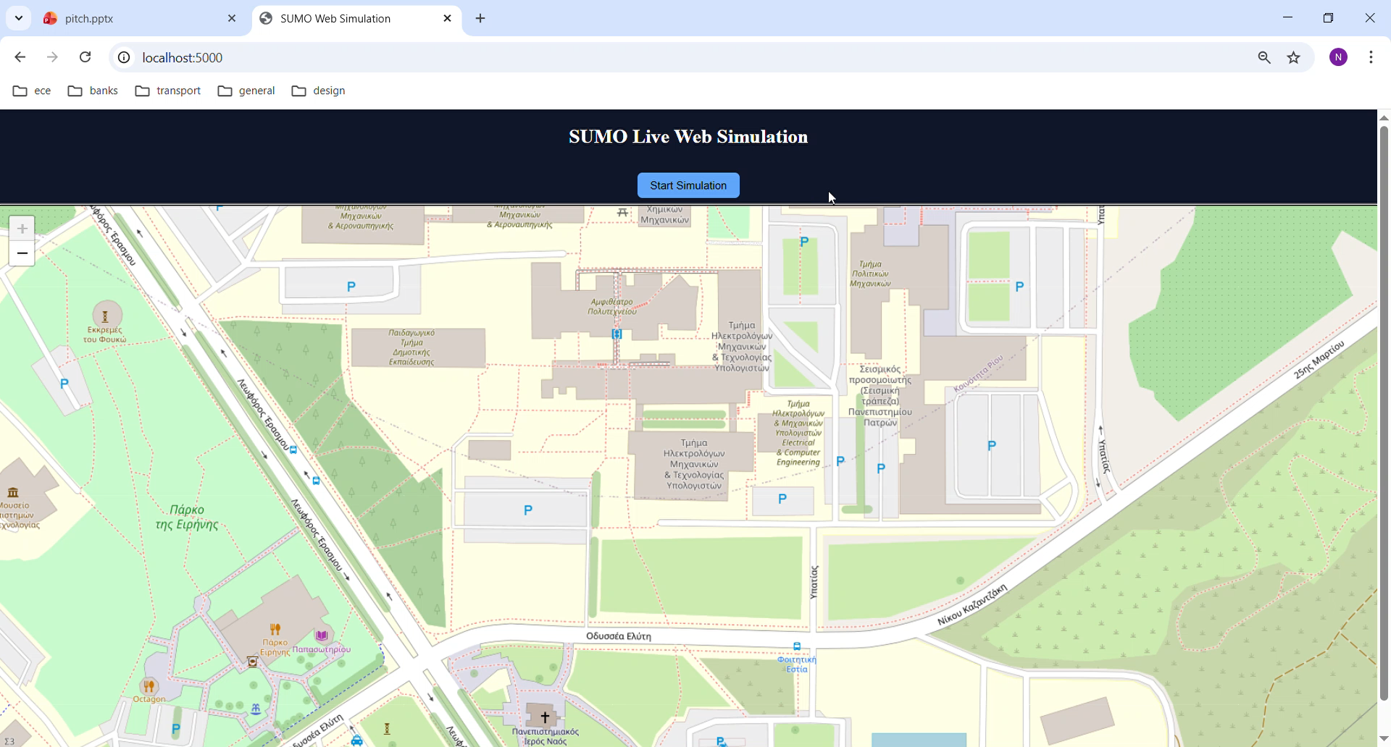
Differentiating Factor
Real-time outdoor personalized
guidance for people and vehicles dynamically directing
them away from fire spread
Evacuation Simulation
Real-time optimal traffic flow modeling
Identification of potential congestion points in the road network
Estimation of the number of parking spaces that may trigger congestion during evacuation
Notes:
ναταλια

Slide 6

Unique proposition
Leveraging existing CCTV infrastructure instead of requiring entirely new sensor network our system is cost-effective and scalable
Crowd monitoring using WiFi/BLE access points estimates real-time pedestrian and vehicle density (parking sensors)
Notes:
ναταλια

Slide 7

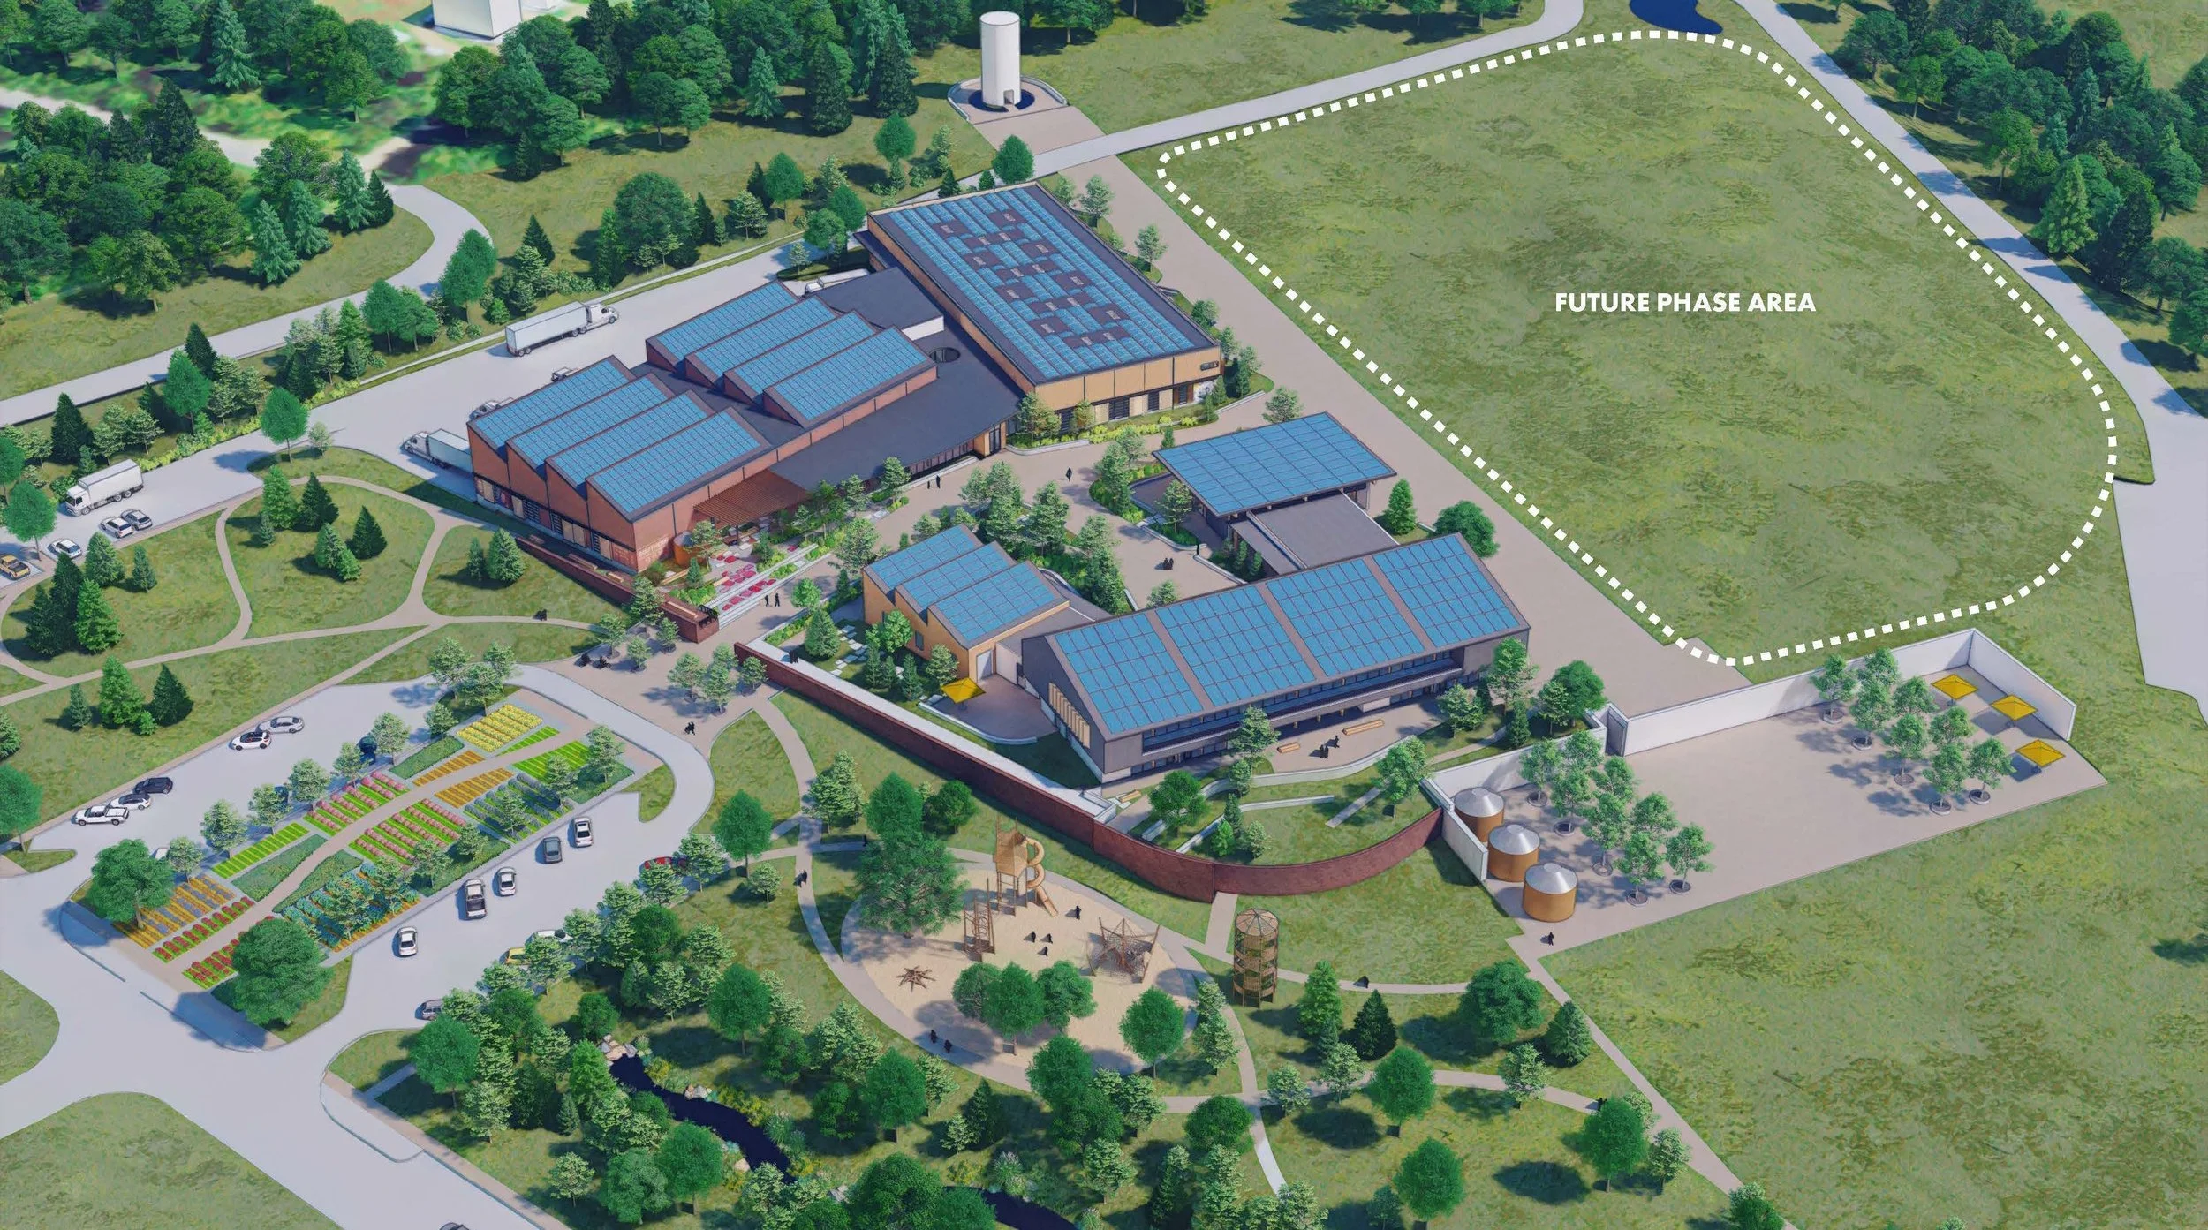
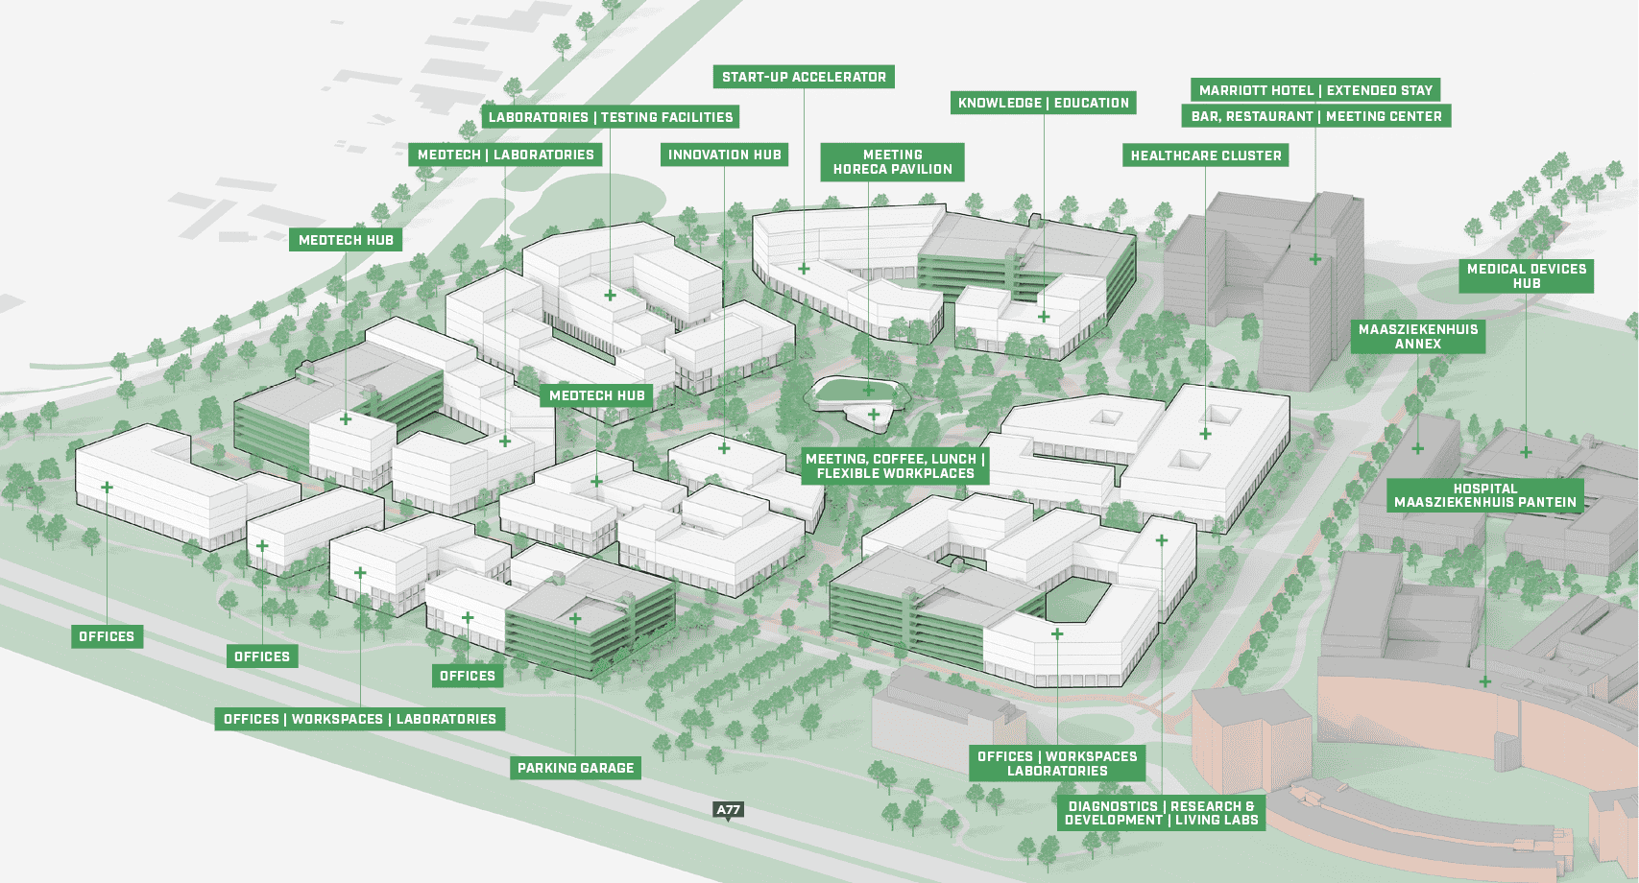
Target Group
Our deployment kit is offered for any organization with a campus
Educational and Research Institutes
Healthcare facilities
Corporate campuses
Government and Military Campuses
Industrial campus
https://www.theindustrialcommons.org/innovation-campus
https://health-innovation-campus.com
Notes:
sotiris

Slide 8
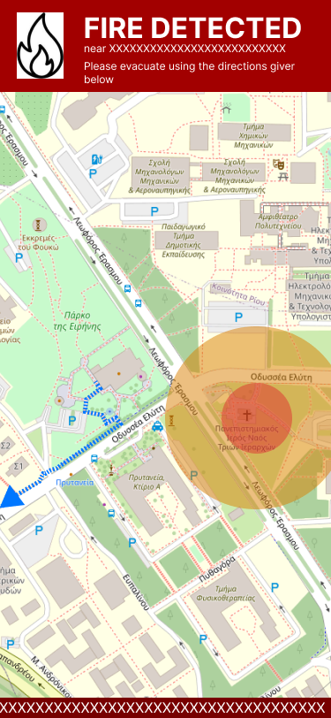
Website Draft User Interface
Display the estimated fire location and the approximate radius of the affected area, enabling the user to make informed decisions based on this information.
Calculate and display the optimal evacuation route for the user to safely exit the area.
Optionally display an informational message provided by the system administrator.
Notes:
sotiris

Slide 9
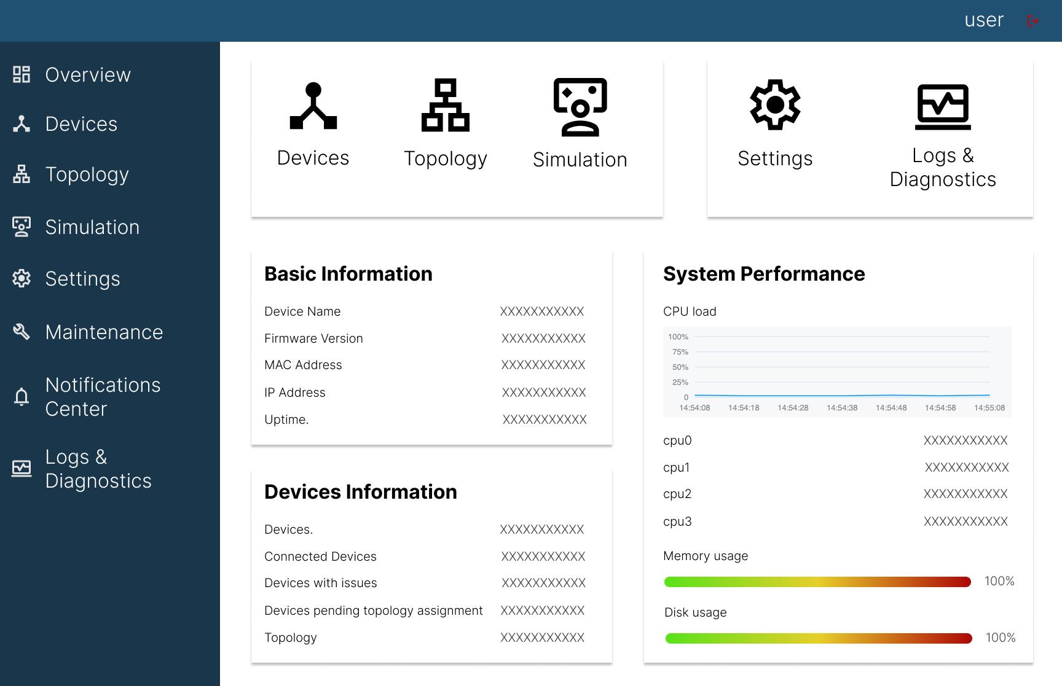
Web Draft Administrator Interface
Manage the cameras accessible to the system.
Set the system’s topology (i.e., the locations of the cameras).
Run simulations to predict how people would evacuate during an actual fire.
Notes:
sotiris

Slide 10
AI model for fire detection
YOLOv8 object detection
detects fire/smoke in real time
Performance: ~97–98% accuracy,
Execution Time: 10-20ms per frame (GPU)
Vram requirements: ~4-6GB
FFireNet(MobileNetV2)
Image Classification
Lightweight CNN
Performance: ~98.4% accuracy,
Execution Time: 5-10ms per frame (GPU)
Vram requirements: <1GB
https://www.kaggle.com/models/datascientist97/mobilenet-v2
https://github.com/autogyro/yolo-V8
Notes:
george

Slide 11
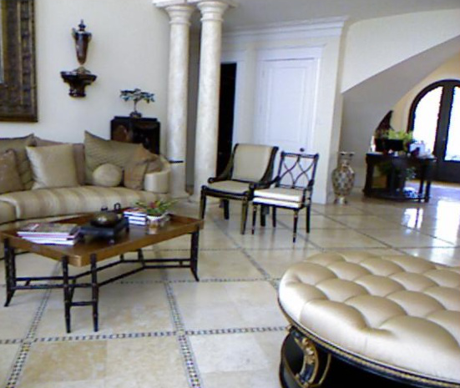
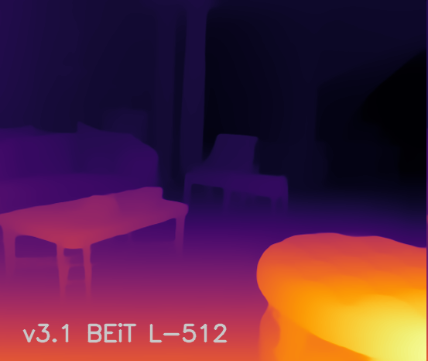
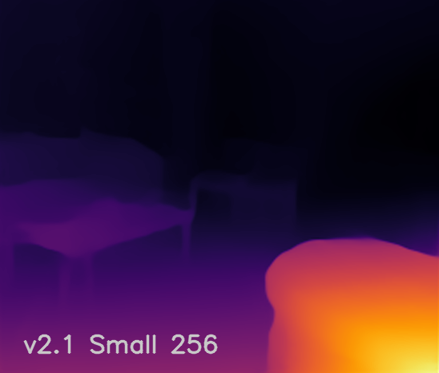
Fire Location Estimation
MiDaS v3
type: Vision transformer
input: RGB CCTV frame
output: depth map -> estimate relative distance of fire
works in indoor/outdoor environments
Performance: ~1-2% relative depth error,
Execution Time: 25-40ms per frame (GPU)
Vram requirements: ~8GB
https://github.com/isl-org/MiDaS
Notes:
george

Slide 12
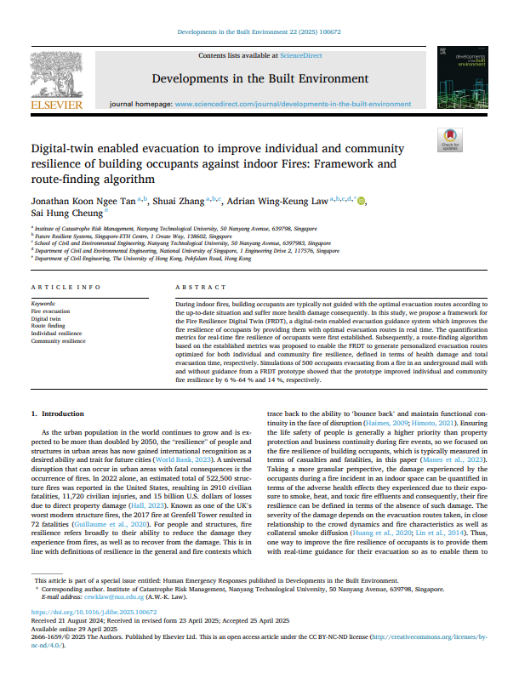
Evacuation
Individual Resilience:
Focuses on the occupant
Provides personalized , optimized ,and safe routes
Community Resiliance:
Focuses on the entire building population
Manages overall occupants flow to prevent bottlenecks
https://www.sciencedirect.com/science/article/pii/S2666165925000729
Notes:
george

Slide 13



Hardware and Pricing (part1)
Scenario for Upatras campus 30,000 users 31departments 4 km²
Parking sensors
500 LoRa parking sensors for parking monitoring
Avg cost/unit: 70€
35,000 €
Cameras
PTZ Required cameras / 1km² : 127
(radius coverage 50m)
500 PTZ cameras for real-time fire detection
Avg cost/unit: 40€
20,000 €
People counting radars
15 LoRaWAN radar sensors for key flow points (restaurant, library)
Avg cost/unit: 390€
5,850€
https://www.skroutz.gr/s/45318780/TP-LINK-C510W-v1-IP-Kamera-Parakolouthisis-Wi-Fi-Full-HD-3MP-Adiavrochi-me-Amfidromi-Epikoinonia-kai-Fako-2-8mm.html
https://market.thingpark.com/yosensi-people-counter.html
https://swiott.com/products/psl02-l-lora-parking-sensor
Notes:
george

Slide 14
Hardware and Pricing (part 2) Server cost analysis for 127 cameras and 30,000 users
Option A : On – Premise Server
3,000 € one time
A single server purchased and owned by the campus
Evacuation server 2,000 €: server (e.g 20-core CPU i7-14700K, 64GB RAM) to manage 30,000 users, the web app, the real-time WiFi data and path planning
AI Hardware 1,000 €: 1x NVIDIA A4000 GPUs to process 127+ streams (1 GPU/60 streams)
Becomes cheaper than cloud service after 7mo
Option B : Cloud Server (AWS) 484 €/month
Renting server capacity
Evacuation server €248/mo: Large CPU instance (e.g c5.2xlarge) to run the algorithm and website while idle
AI Hardware €384/mo: 1x T4 GPU instances to process the 127 camera streams 24/7 (39 streams)
The server cost will spike during actual evacuation
https://costcalc.cloudoptimo.com/aws-pricing-calculator/ec2/c5.2xlarge
https://costcalc.cloudoptimo.com/aws-pricing-calculator/ec2/g4dn.xlarge
Notes:
sotiris

